Slide 1

Final challenge
Domain: Hospital readmission
Name: Faisal Guleed
AI / ML & Data Main semester

Slide 2
Demo

Slide 3
Why does this matter?
Increased healthcare costs
Hospital capacity
Poor patient monitoring

Slide 4
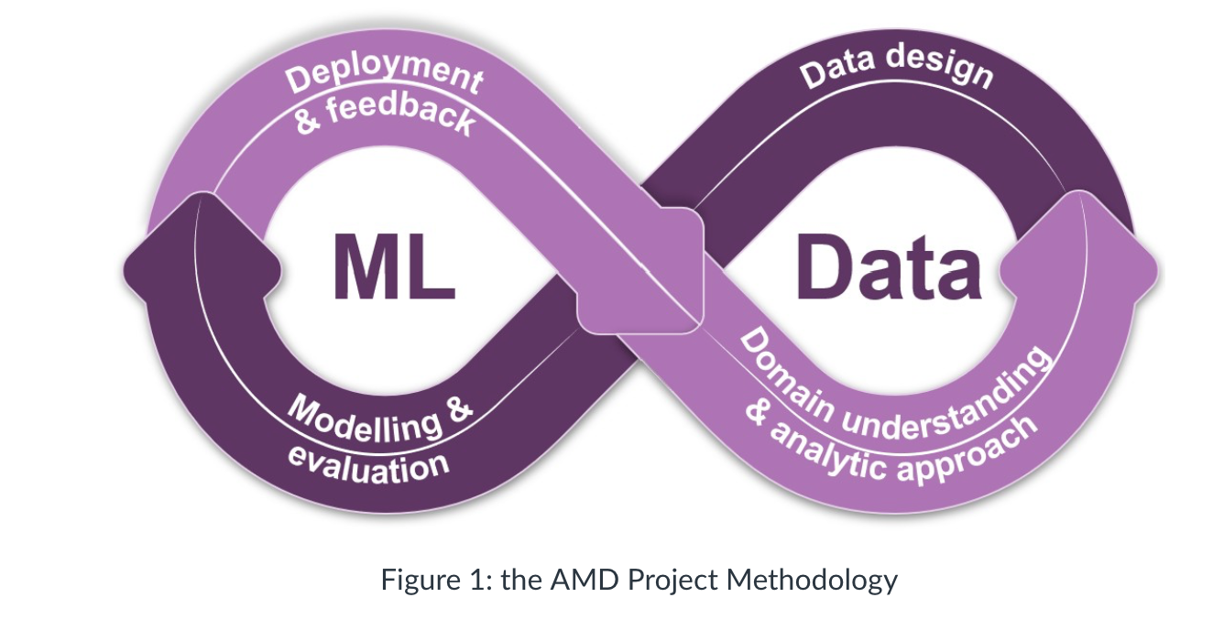

Slide 5
Domain analysis
Literature research
Diabetes managements causes lower readmission rates
Feature set
Model considerations (predicting a continious value rather that 0/1)
Data availibility & limitations
Target design (30 days readmission)
Ethical considerations
Explainainable AI

Slide 6
Feedback from domain teacher
Examine the representativeness of dataset
Quickscan framework (Ethical reflection)
Risk level per group

Slide 7
Research question
Can historical hospital data be used to estimate the risk of readmission within 30 days for patients with diabetes?

Slide 8
Data design
30 days readmission
Frequently used timeframe within healthcare
>30 = 0 results in information loss (outside of the project scope)

Slide 9
Analytic approach
Linear regression
Logistic regression
Tree based models
Limited predictive performance
One common denominator: Data quality issue

Slide 10
What if exact readmission days had been available?
Current dataset labeling
Dataset with more specific labeling
Actual readmission | Dataset label (categorical)
2 days | <30
29 days | <30
31 days | >30
No readmission | NO
Actual readmission | Dataset label (int)
2 days | 2
29 days | 29
30 days | 30
31 days | 31
No readmission | 0

Slide 11
Model comparison
Model | Reason tested | Outcome | Why selected/ not selected?
Linear regression | Continious risk score | Similar performance | Best model overall
Logistic regression | Binary classification baseline | No substantial improvement | Less aligned with stakeholder preference
Decision tree | Non linear relationships | Limited gains | Reduced interpretability
Random forest | Stronger predicive power | Small improvements not sufficient | Lower explainability

Slide 12
Final model
Linear regression
Why?
Interpretability
Teacher discussions
Produces a continuous risk score

Slide 13
Model results
Metric | score
MAE | 0.19
RMSE | 0.31
R^2 | 0.02 (2%)

Slide 14
Stakeholder interpretation
Risk score | Interpretation | Possible actions
0.00 – 0.06 | Low risk | Standard discharge process
0.06– 0.15 | Moderate risk | Consider follow-up contact
> 0.15 | Higher risk | Additional review or support
Output = Risk score not probability!
Risk score of 0.03 = low
Risk score of 0.11 = moderate (Average of risk scores)
Risk score of 0.20 = higher than average
Thresholds only for demonstration purposes

Slide 15
Deployment & feedback
Streamlit dashboard
User friendly UI design
Model data saves
Reproducable to a certain extent

Slide 16
Future improvements
More detailed readmission data
Add additional clinical features (Disease severity, socioeconomic factors)
Explore different modelling approaches (multiclass classification)

Slide 17
Reflection
Data quality > Model complexity
Importance of domain analysis

Slide 18
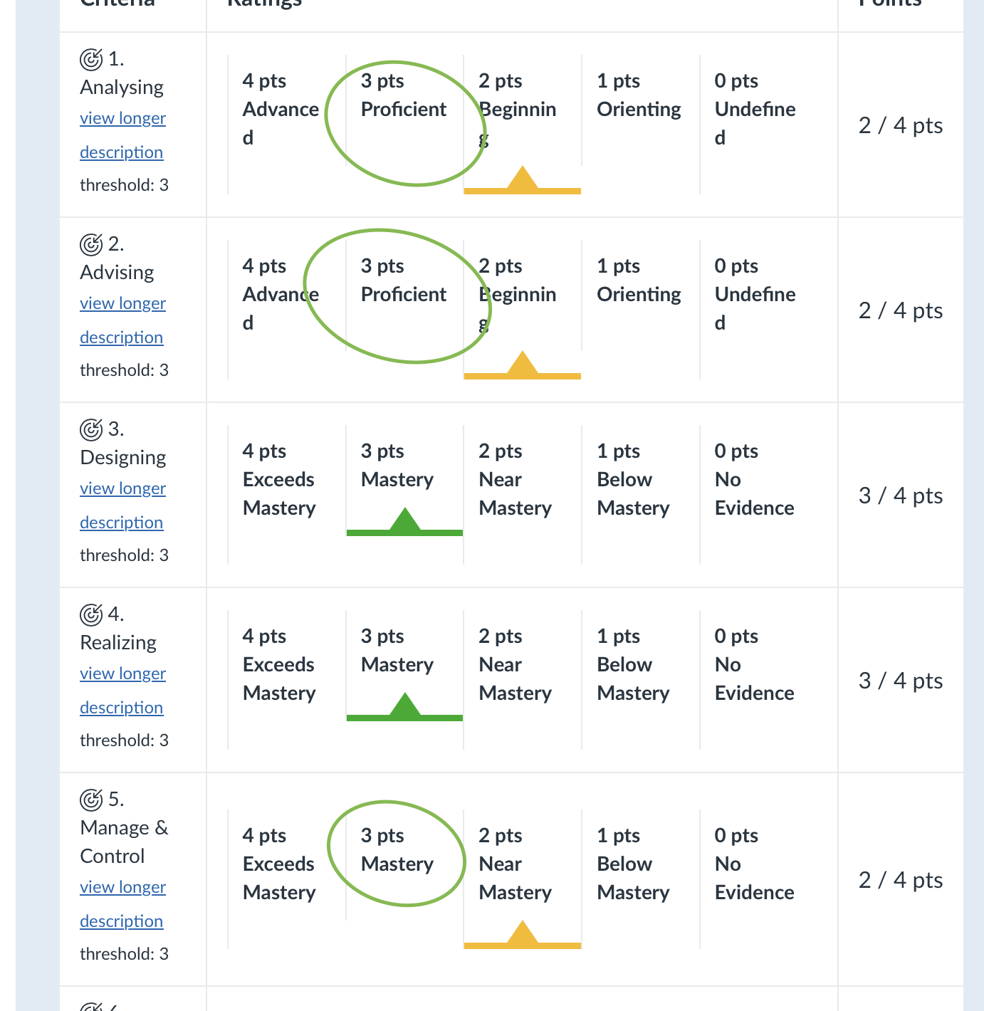
Reflection on learning outcomes
Domain analysis validation (Senne & John)
Explainable AI

Slide 19
Questions

